Slide 1

WEB APPLICATION DEVELOPMENT PROJECT
PRESENTATION
On
Medical Shop Online
By
Group ID: G28
Jinay Shah (20162121025)
Purav Shah (20162121026)
Tirth Patel (20162121029)
Institute of Computer Technology
Ganpat University
Date:06-05-2022

Slide 2
Abstract
The establishment and improvement of doctor-patient (student/staff) interaction system is a very important requirement, especially now when the communication technology is developing rapidly. The advantages of web can be made full use of to make up the time and distance gap between doctors and patients and to provide fast and adequate medical services. Through the connection between user terminals and specific service, both doctors and patients are able to obtain required data to achieve a better interaction. The platform, Web services and database technology are all gradually maturing, so that we can develop a doctor- patient (student/staff) interaction system on web application platform to meet the needs of the patient and provide doctors more efficient and convenient means of communication with patients. Doctor can see the complaint and provide the necessary solutions for the patients. Admin can manages the patient record in efficiently. Using the web portal admin can also generate the day/weekly/monthly reports.

Slide 3
Objective And Scope
Objective:
Our objective is to deliver medicines and health products at the customer’s doorstep in minimum time and in reasonable price.
Without leaving their house user can interact with the specialist doctor via virtual video meeting.
Scope:
Our main scope is to cut our delivery time and reduce the price of products and we want to add as many products as we can.

Slide 4
Related Background
Target user:
Our website target all age groups like children, adults and old age. But our main target is on people of age groups like 35-75.Because as age increases, for many people the number of diseases increases like blurry vision, problems in walking etc.
Competitive analysis:
Our main competitors are Tata one mg, Pharmeasy, Netmeds, Apollo, MedplusMart.
These well known websites already have many customers who prefer to order from these websites, as they provide heavy discounts with many offers.
Delivery time is also less, So in order to stand out among these websites new Start up’s coming in this field have to give facilities.

Slide 5

PERSONA 1
“I have to take care of my parents but I have no time to go to the drug store to buy medicines for them”
Goals
He wants to become Gr. Manager in the firm
He is working
To take care of his parent
Frustrations
Can not go to the drug store while working
Lack of time
Rupesh completed his graduation at the age of 22.After graduation he got the decent job in Ahmedabad.Now After 5 years of his experience his responsibilities has been increased,
So he is not getting time to go to drug store and buy medicines for his parents.
Rupesh
Age:
Education:
Hometown:
Occupation:
27
B.E. (MECHANICAL)
Ahmedabad
Job

Slide 6

PERSONA 2
“Being a diabetic patient I can’t walk much around, also It is difficult me to see because my vision is blurry hence it become difficult for me to go and buy medicines for me”
Goals
Wants to stay healthy and live long
He wants to get his medicines at lower price at his doorstep
Frustrations
Can not go to buy the medicines because of blurry vision.
He is frustrated of his illness and pain
Suresh bhai is retired man for around 7-8 years. And his son and daughter-in-law are living in Canada. Being alone at home and a diabetic patient he is searching for the solution so that he can order medicines from home.
Suresh Bhai
Age:
Education:
Hometown:
Occupation:
65
12th (Pass)
Gandhinagar
Retired

Slide 7
Advantages-Disadvantages Of Websites
1. Tata 1mg
Advantages:
We don’t have to search our regular medicine by it’s name, we can just upload our
prescription and all medicines will be add to cart.
If we have time constraint we can consult with doctors via chatting/calling.
Disadvantages:
Navbar disappears while scrolling.
Can’t see products image in cart section so it becomes necessary for the buyer to read the medicine name compulsory.

Slide 8
Advantages-Disadvantages Of Websites
2. Netmeds
Advantages:
Before proceeding for the payment we can see approx delivery date.
Disadvantages:
This website is not much enjoyable as in cart some of the buttons don’t have background color.
Categories of products and number of products are very less compared to others.

Slide 9
Advantages-Disadvantages Of Websites
3. Pharmeasy
Advantages:
They have option called express delivery so medicines can arrive in few hours.
They have too many payment partners so user can easily purchase medicines.
If we don’t have prescription still we can buy medicines and select Free Doctor Consultation at checkout.
Disadvantages:
Company’s contact details are not given.

Slide 10
Advantages-Disadvantages Of Websites
4. Apollo Pharmacy
Advantages:
They have detailed description about particular medicine.
Disadvantages:
The content of home screen is too small.
This website is not much enjoyable.

Slide 11
Advantages-Disadvantages Of Websites
5. MedPlusMart
Advantages:
Delivery in some areas like Hyderabad, Vijayawada, Chennai, Nagpur, Bengaluru is fast because offline stores are also present in that areas.
Heavy discount is given if we buy products in Bulk.
Disadvantages:
Services of Medplus is available in very less areaslike Hyderabad, Vijayawada, Chennai, Nagpur, Bengaluru.
Refund policy is bad.

Slide 12
Expected Outcome
Due to pandemic many people had fear to go in public and buy medicines and besides that many aged people live alone so they can’t go to the store to buy medicines, and many people work from early morning to late night so they have no time to go the drug store and buy the medicines.So people can order medicines from our website.
Also at clinic or hospital where there are plenty of patients with some disease or problems so to avoid coming in touch with them.
Our website will provide online meeting facility for patients to arrange a virtual meeting from home without going to clinic or hospital.

Slide 13
Tools & Technology
Minimum Hardware Requirements :
Laptop / Desktop
Processor - 1GHz or Above
Ram - 1GB or Above
Free Disk Space - 30GB or Above
Internet Connection
·

Slide 14
Tools & Technology
Minimum Software Requirements :
Eclipse IDE 2021-12 4.0 or higher
Apache Tomcat Server v10.0 or higher
JDK 12.0 or higher
JavaSE-14 or higher
JRE 6.0.1
MySQL Workbench 8.0 or higher
Bootstrap
MDBootstrap
·

Slide 15
Methodology (Modules)
Client/User Module:
Login Page
Signup Page
Forgot Password Page
Home Page
Products Page
Doctor’s Appointment Page
Customer Wallet Page
Your Account Page
Reset Password Page
Cart Page

Slide 16
Methodology (Modules)
Admin Module:
Login Page
Dashboard Page
Add Product Page
Modify Product Page
Delete Product Page
View Product Page
View Users Page

Slide 17
Process Flow Diagram
Click Here To See:
https://drive.google.com/file/d/18Bm6VlNjA6h38Z9s36Wn8TvIQdqj3Kum/view?usp=sharing

Slide 18
References
StackOverflow
JavaTPoint
MD Bootstrap
BootStrap
Font Awesome
W3Schools
TutorialsPoint
Pharmeasy
Tata One mg

Slide 19
Screenshots

Slide 20
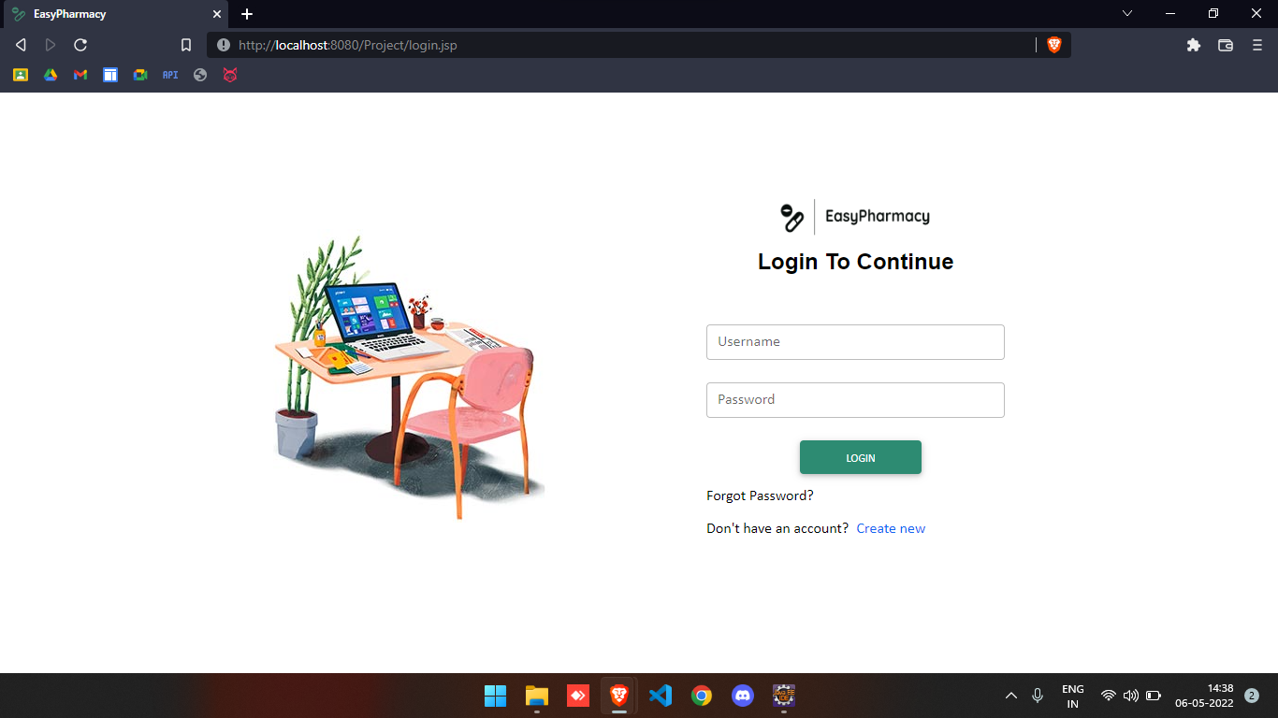

Slide 21
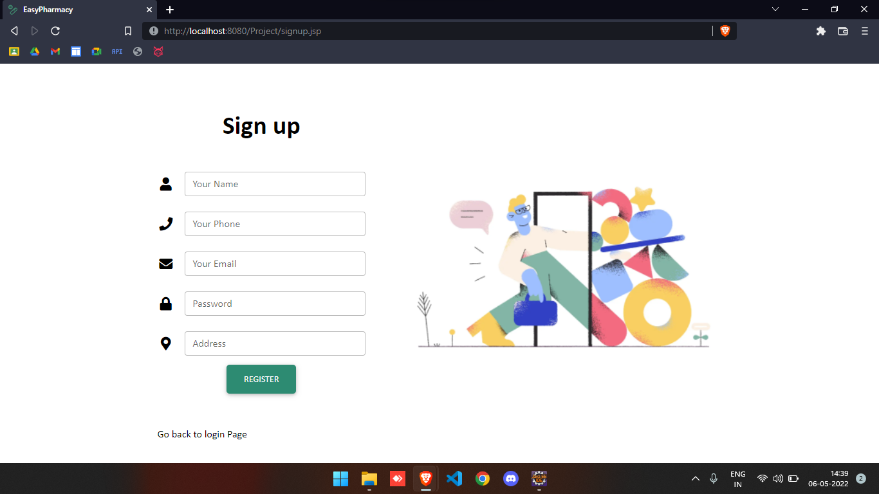

Slide 22
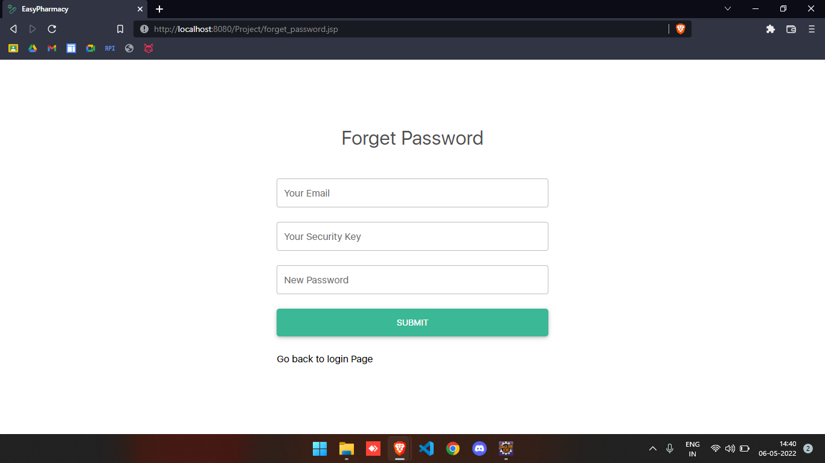

Slide 23
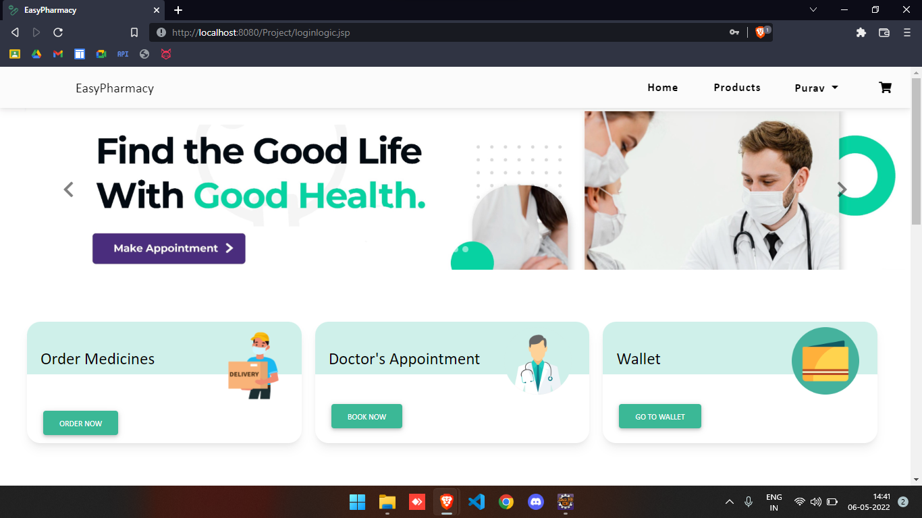

Slide 24
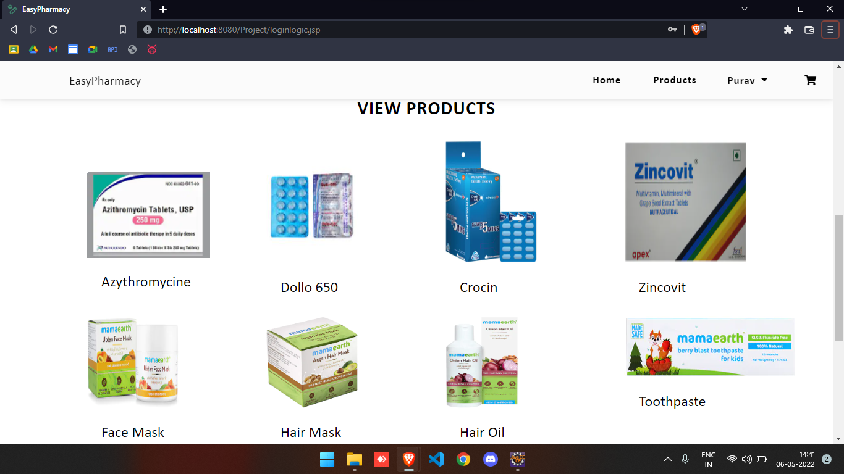

Slide 25
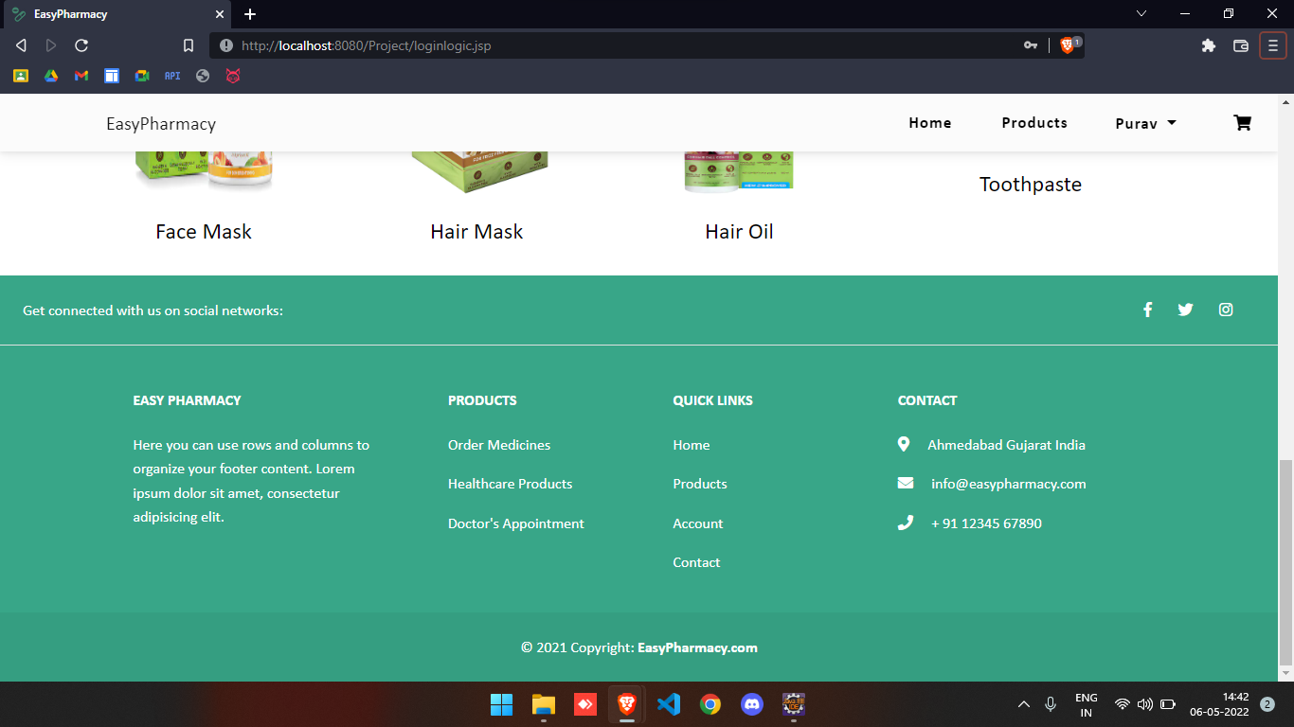

Slide 26
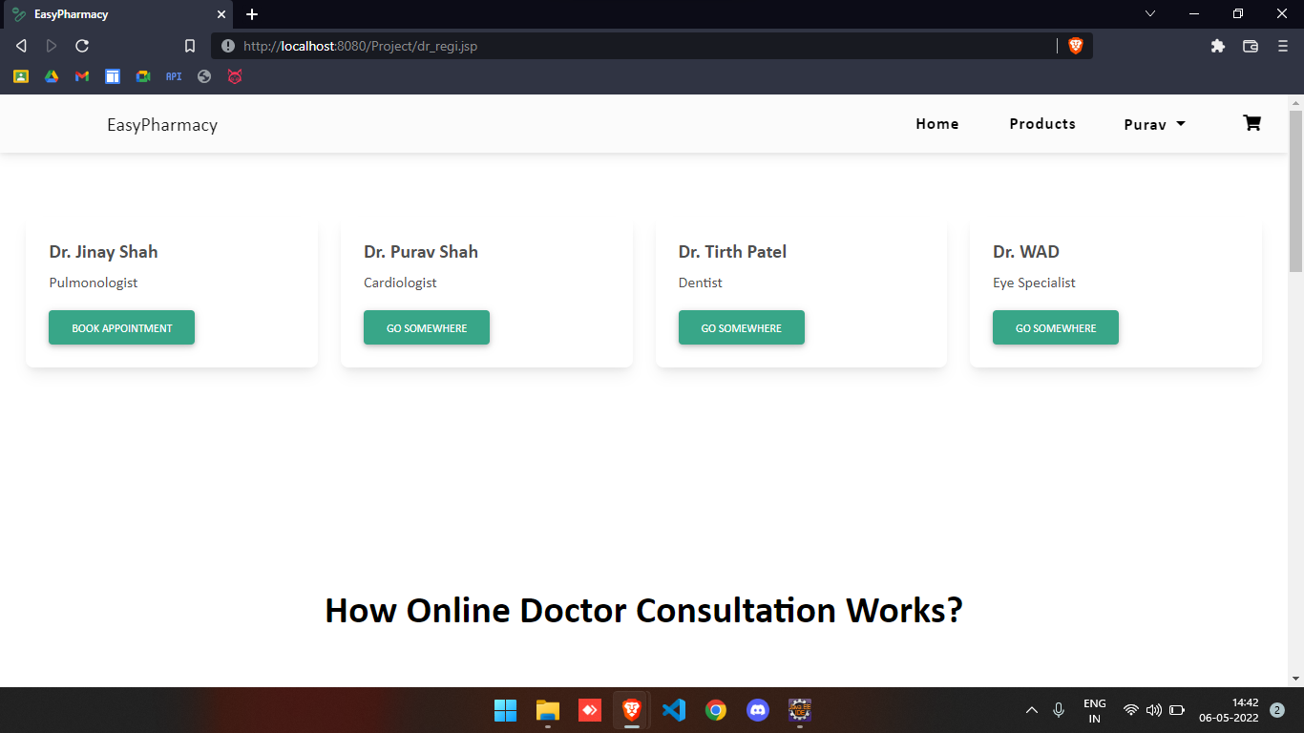

Slide 27
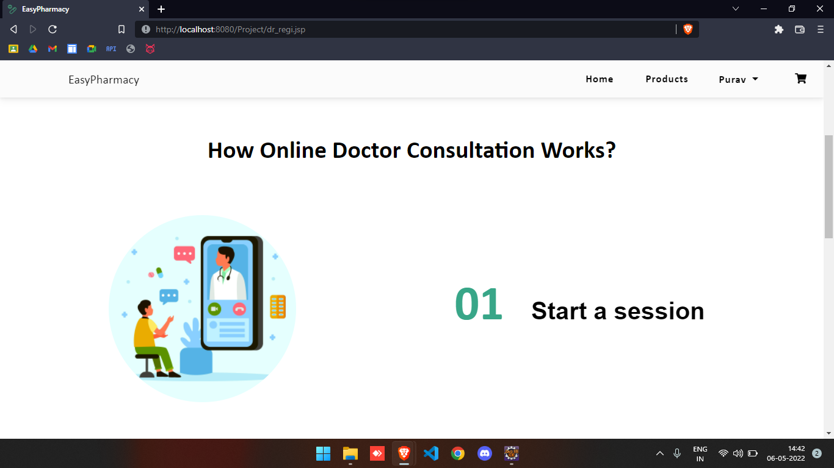

Slide 28
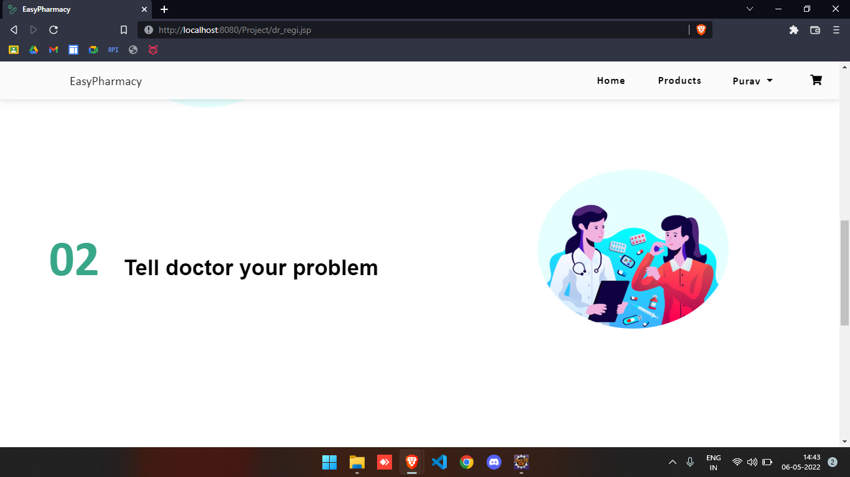

Slide 29
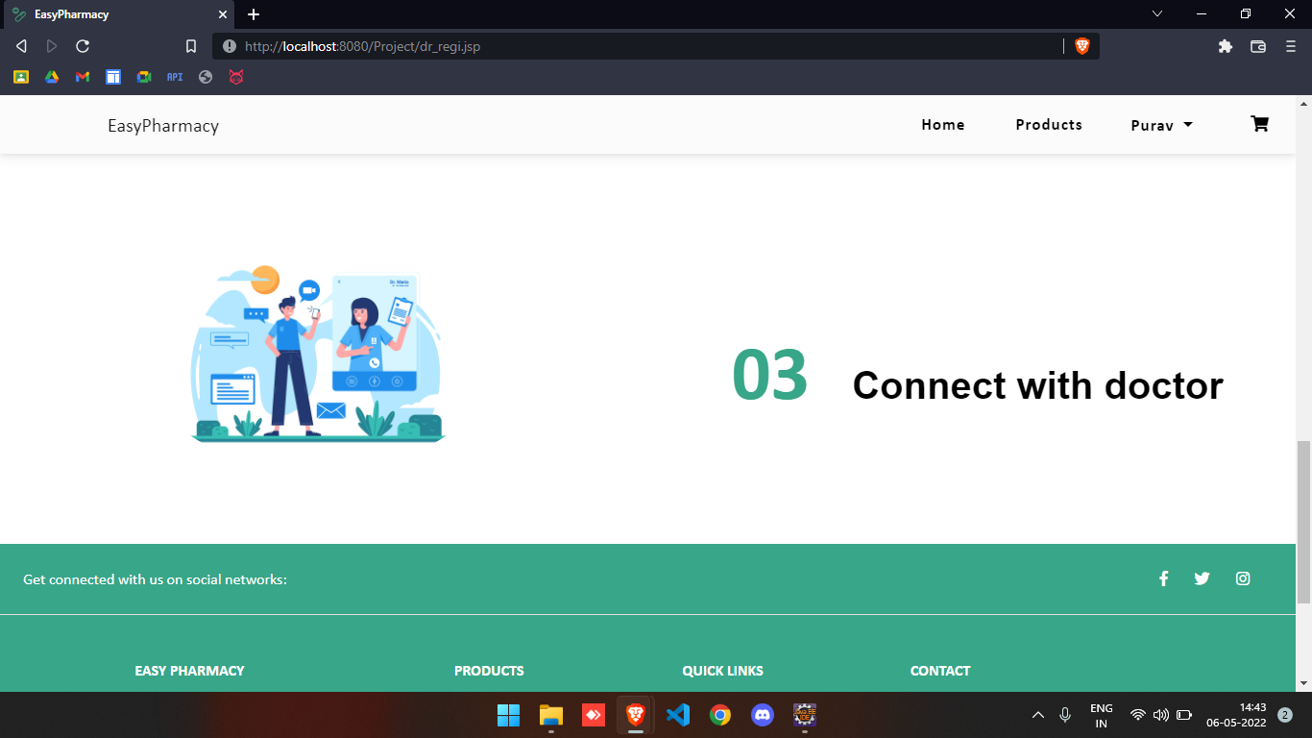

Slide 30
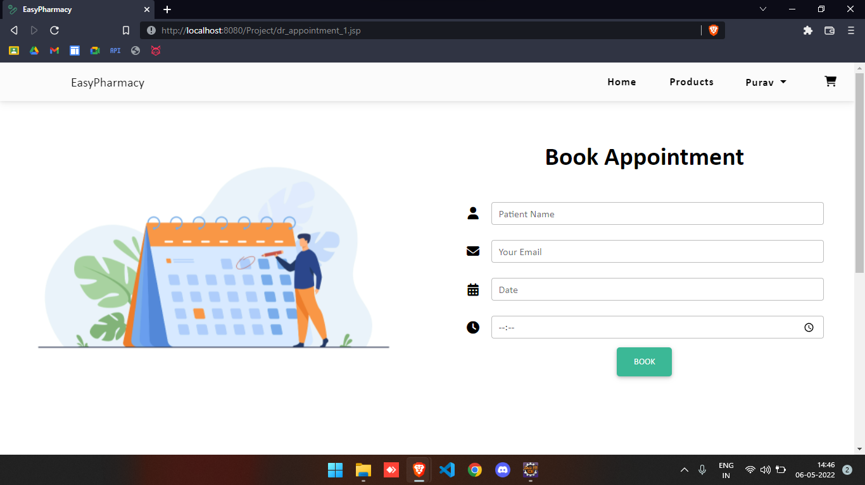

Slide 31
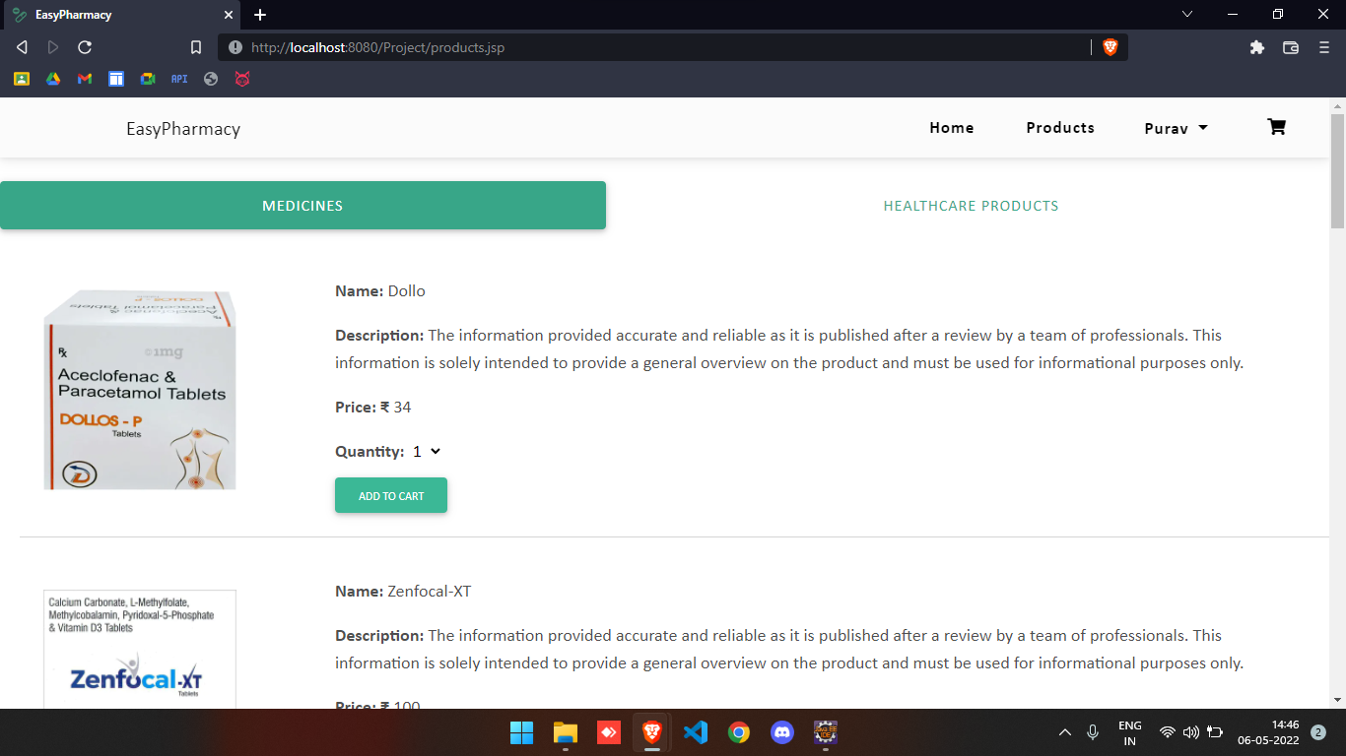

Slide 32
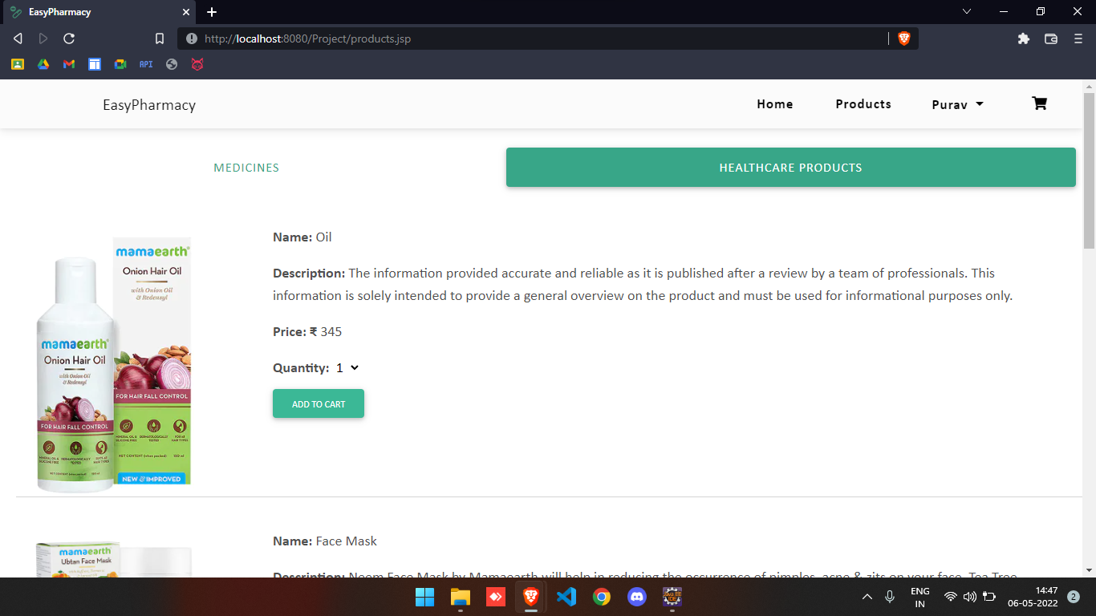

Slide 33
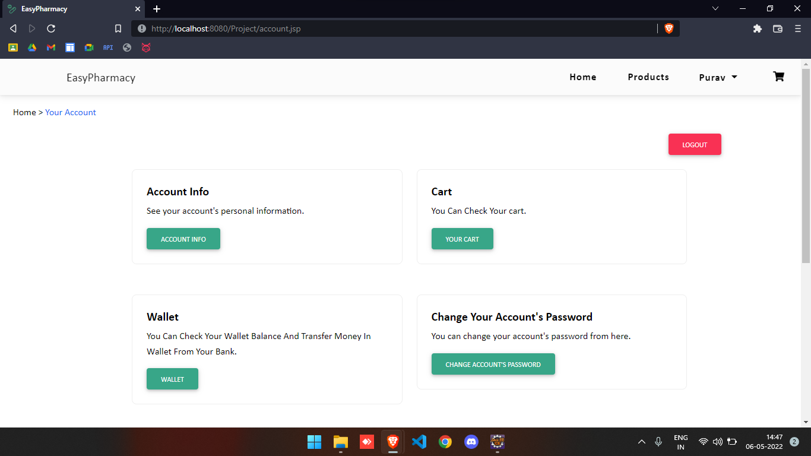

Slide 34
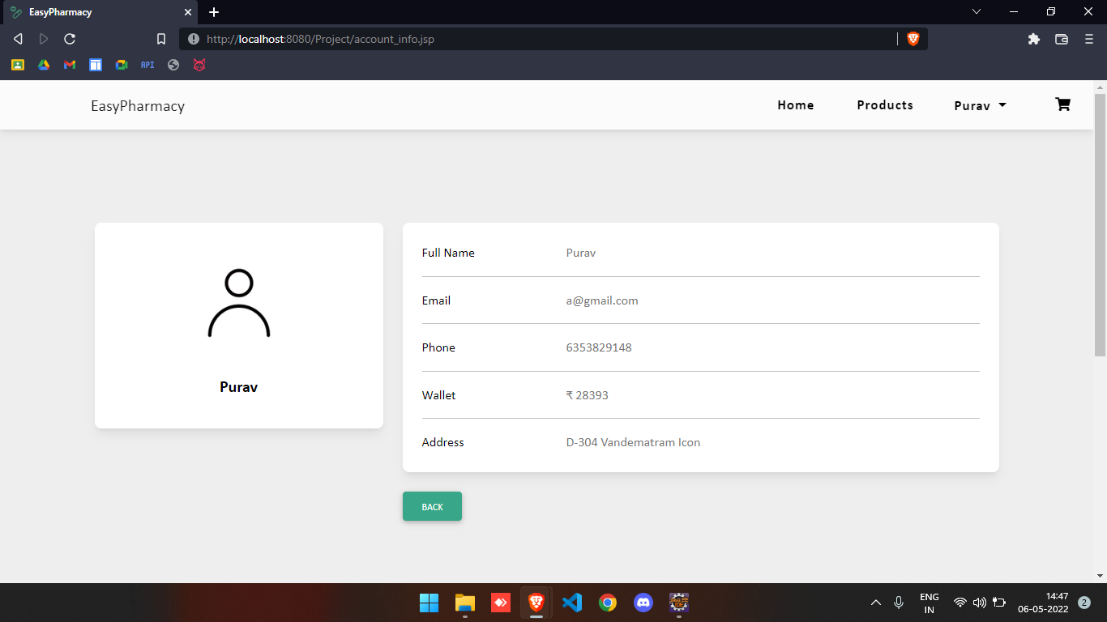

Slide 35
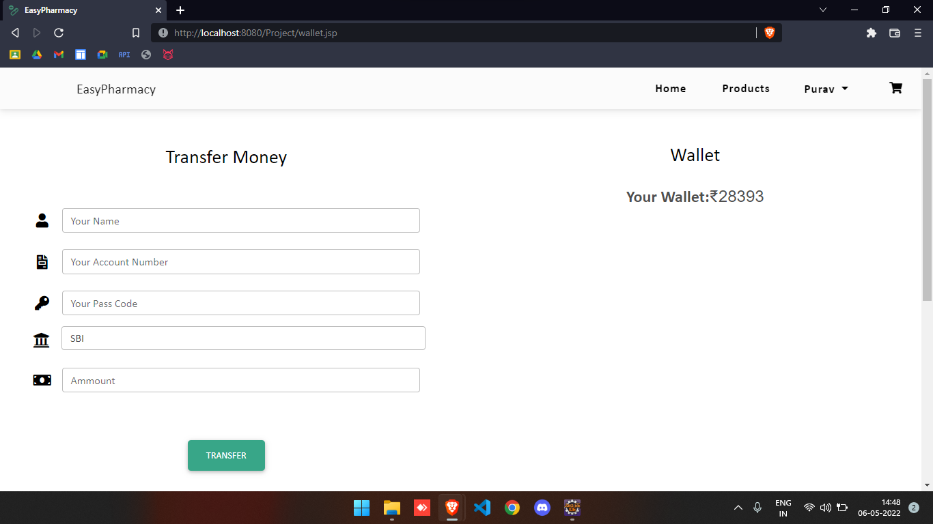

Slide 36
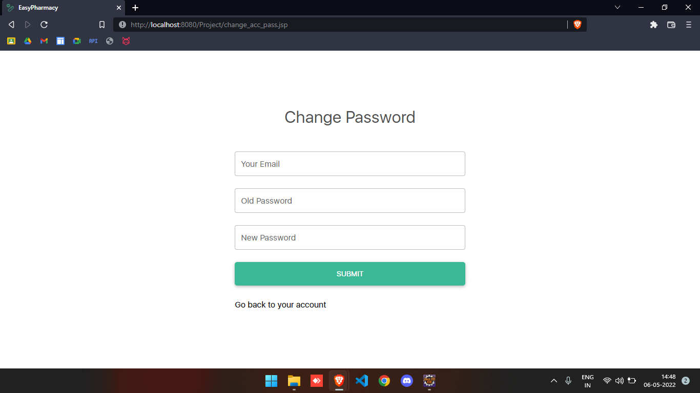

Slide 37
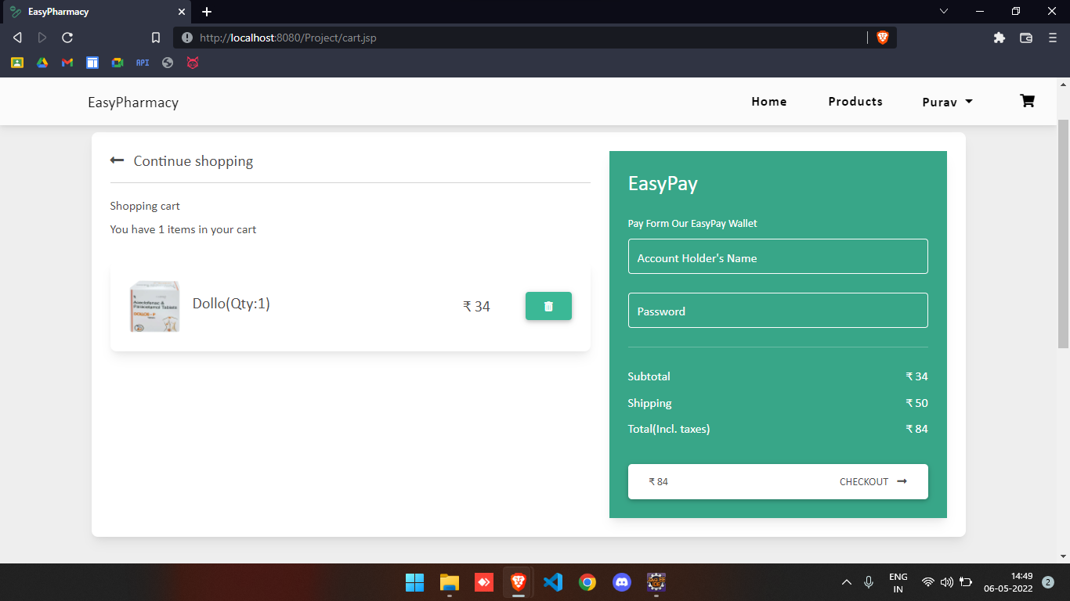

Slide 38
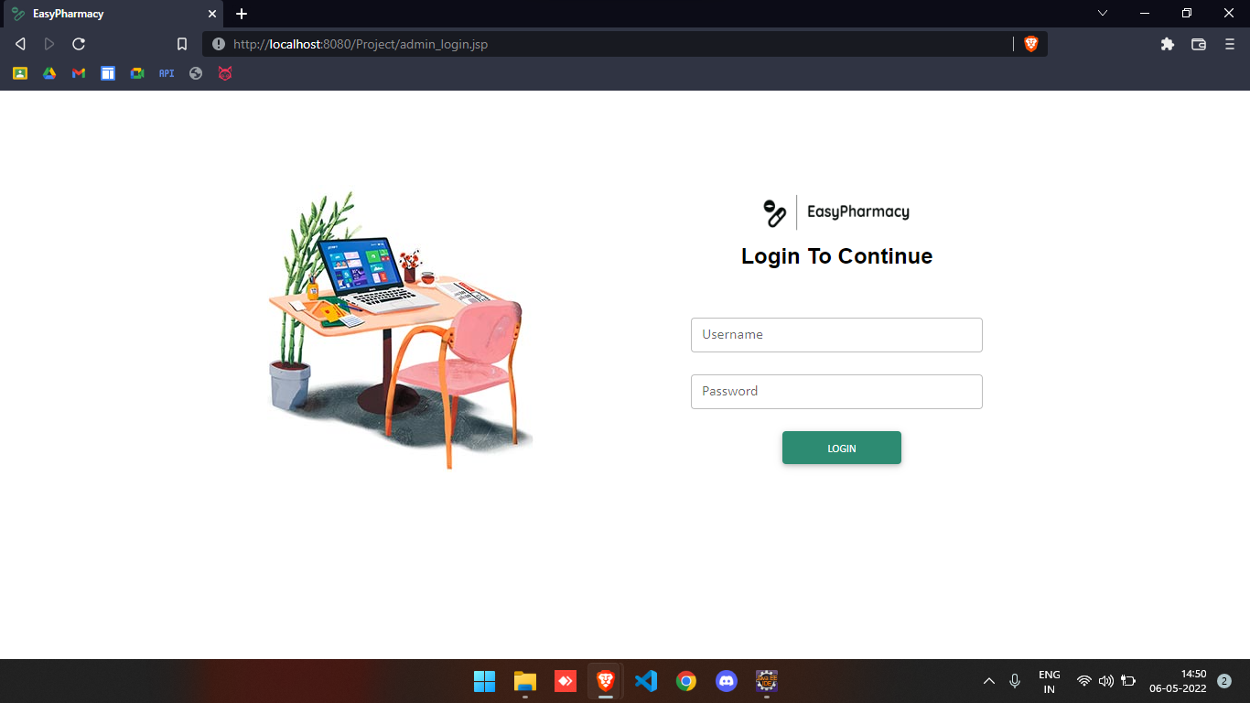

Slide 39
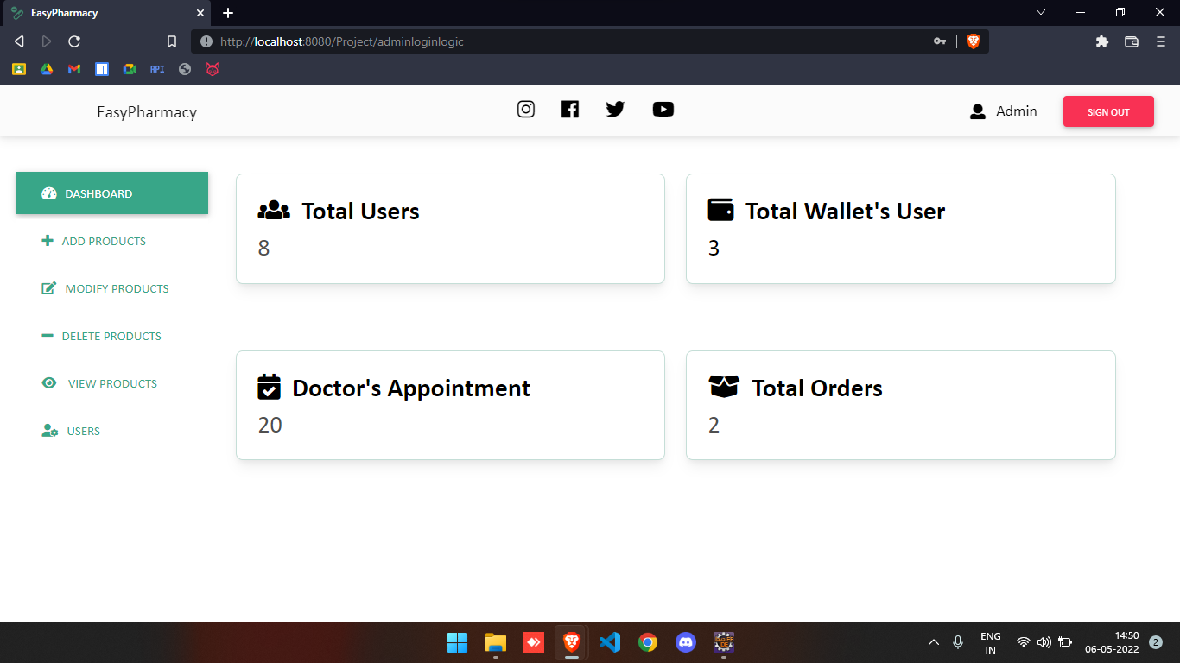

Slide 40
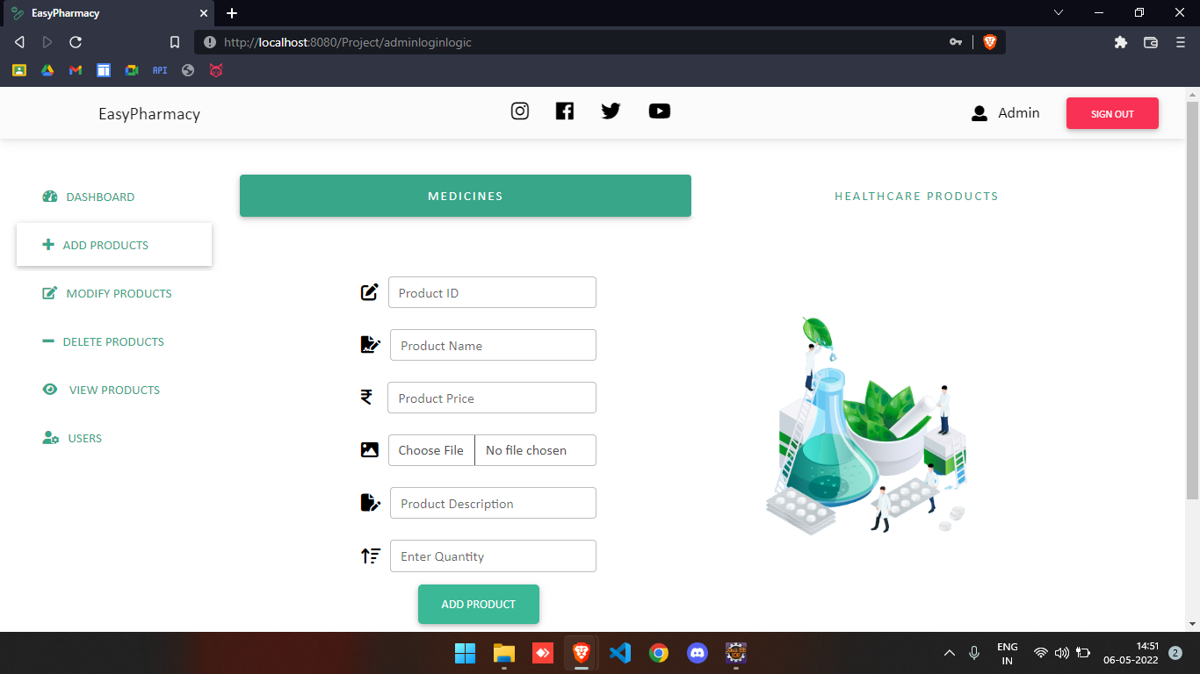

Slide 41
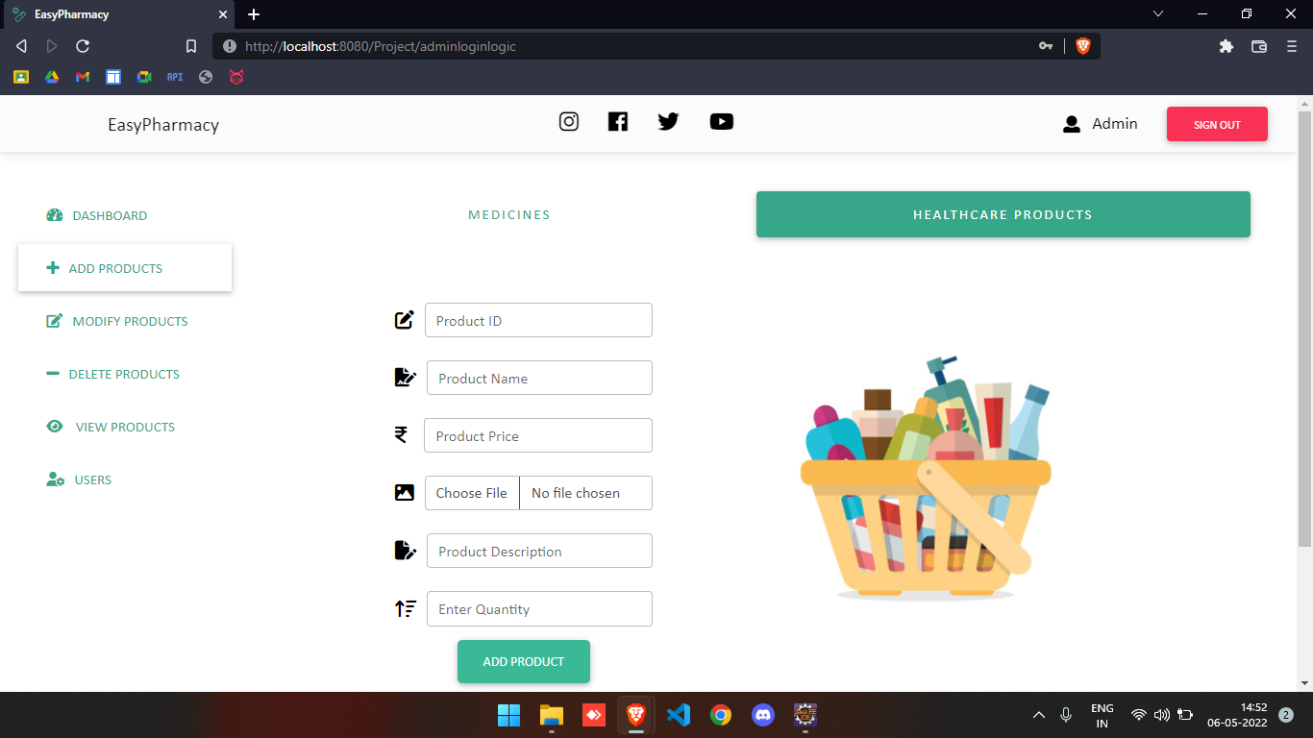

Slide 42
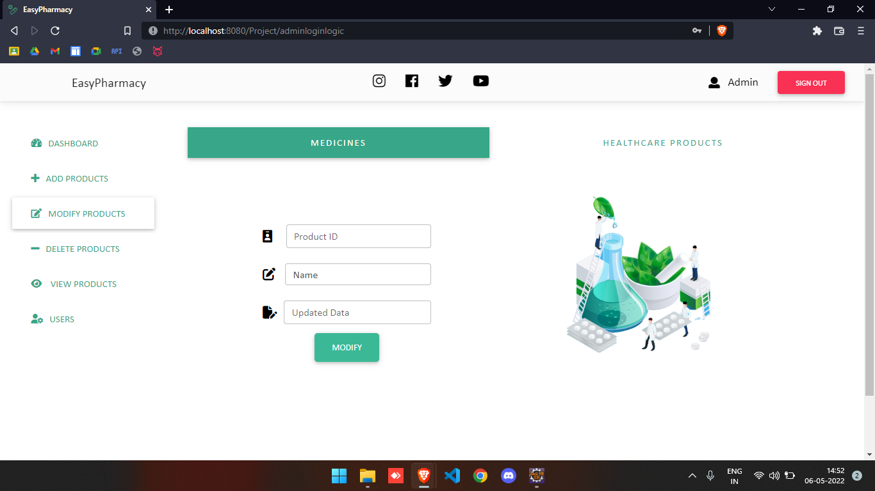

Slide 43
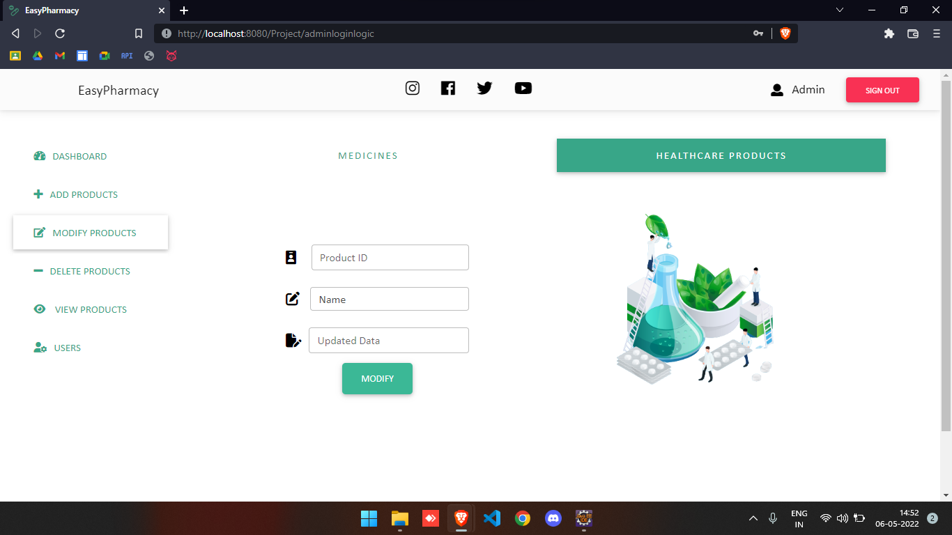

Slide 44
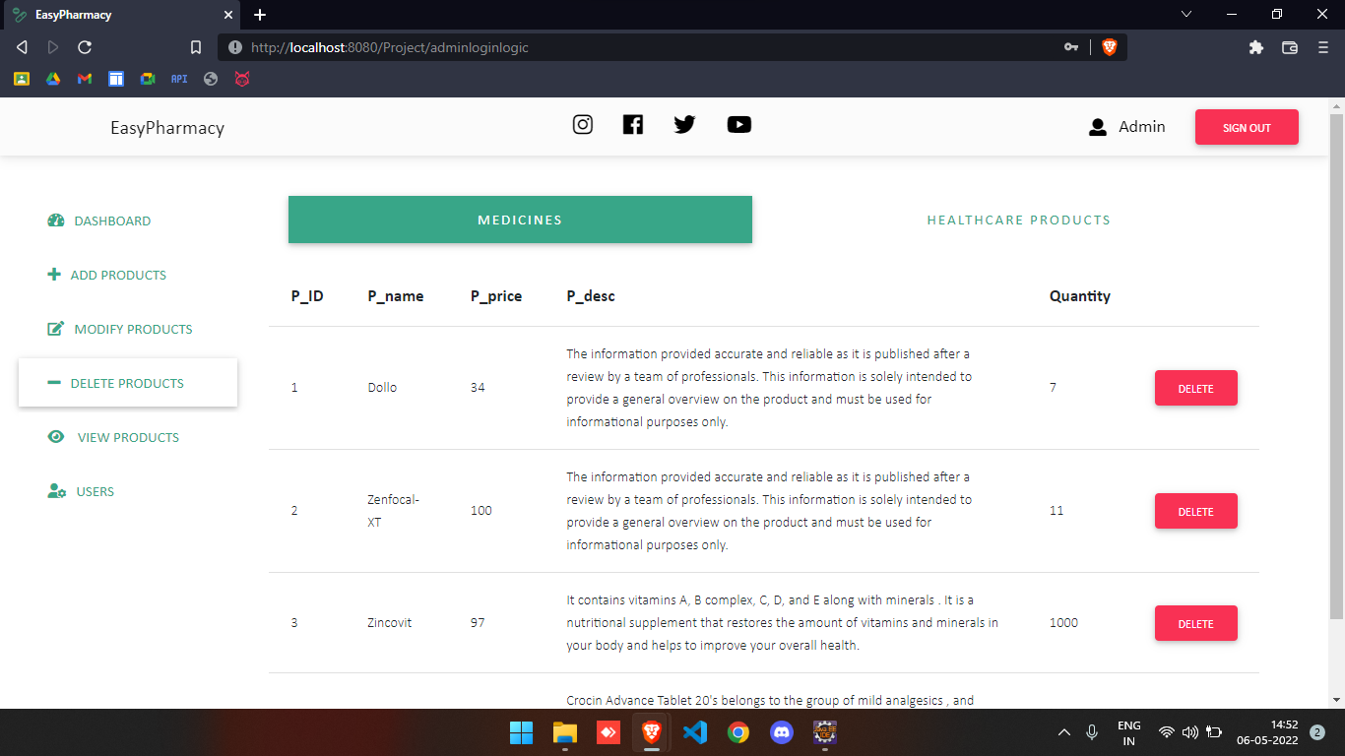

Slide 45
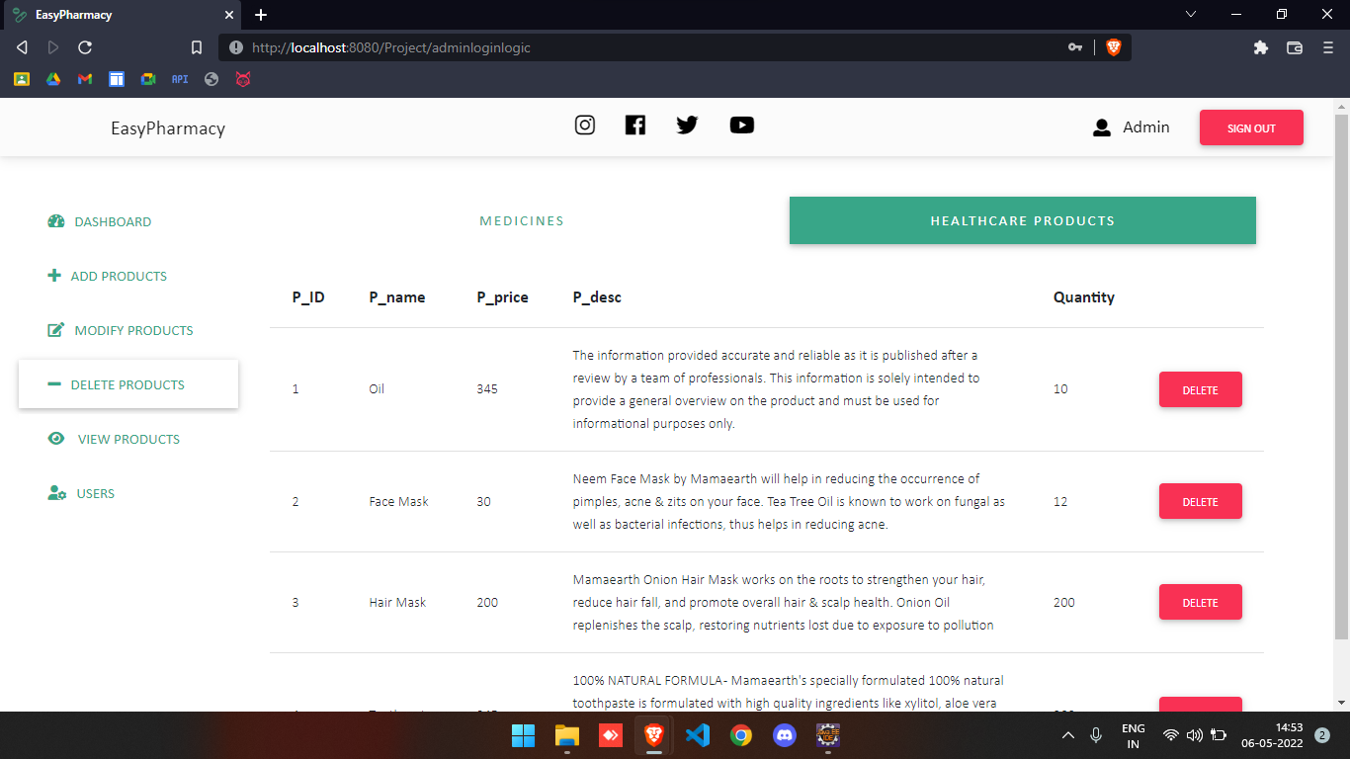

Slide 46
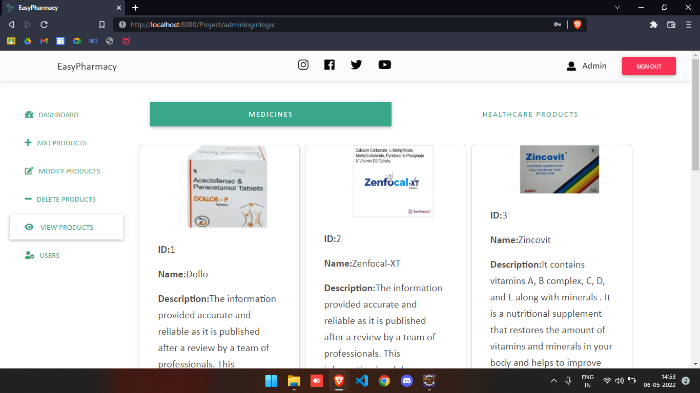

Slide 47
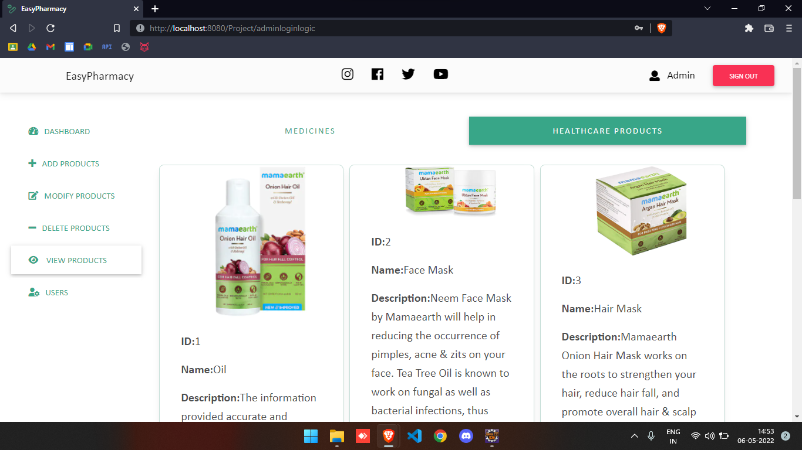

Slide 48
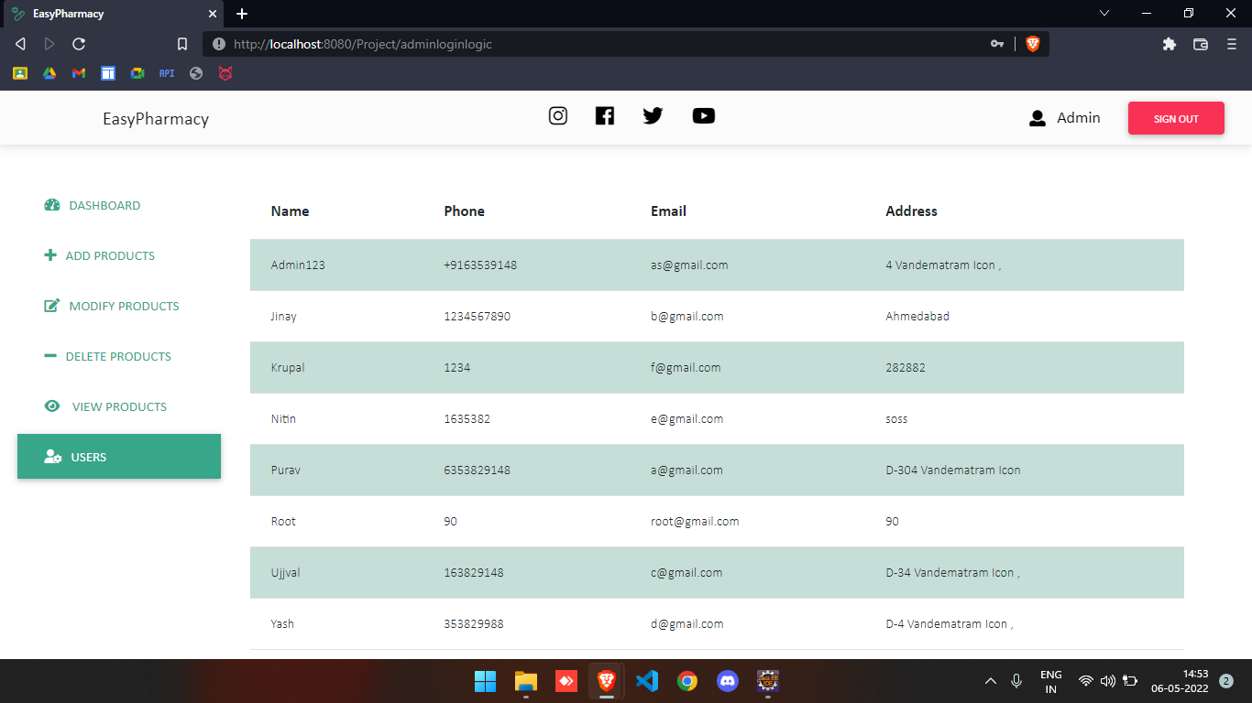

Slide 49
Conclusion
Our project’s main conclusion is to make patient and doctors interaction in a much easier way. With the help of online interaction doctor patient transportation cost will be null. Also our goal is to supply every medicines and medical related and healthcare product in the affordable price by giving patient different types of discount. The project is made using UI/UX ideas. The EasyPharmacy website is almost a Full fledged project which can deployed with some modifications. We will further expand the products types and quantity of products. This website is very easy to use and user friendly. In Future we can also add one module in which pharmacy shops can be involved so that the inventories can be minimized so that the delivery man can take medicines from the respective and registered medical shops as well as Healthcare shops and deliver it to the end users.

Slide 50


